Slide 1

LANGUAGE TRANSLATOR
Name: Piparva Ravi S.
Roll no.:IT092.
Id:17ITUOS090.
Name: Prachi Sanjay Kumar Chaudhari.
Roll no.:IT093.
Id:17ITUTS065.

Slide 2
Language Description.
Depending upon the State, various terms are being used across the nation to denote the area of a landed property. In order to better understand the offer of a seller, the terms as mentioned in the land documents, and to calculate the value of land, it is always advised to have an idea of the common land measurement units used in India.
Hectares, acres, square meters, and square yards (Gaj) are some of the common land measurement units used across India.
Depending upon the names of the units, their sizes also vary from State to State.
So land unit conversion is necessary and useful.

Slide 3
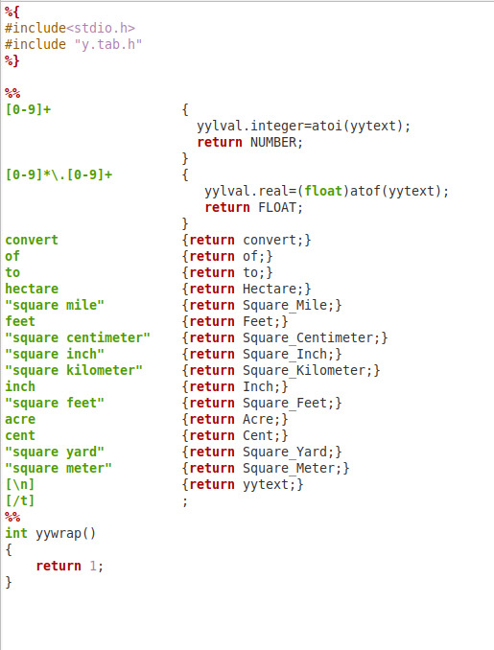
Flex File:temp1.l

Slide 4
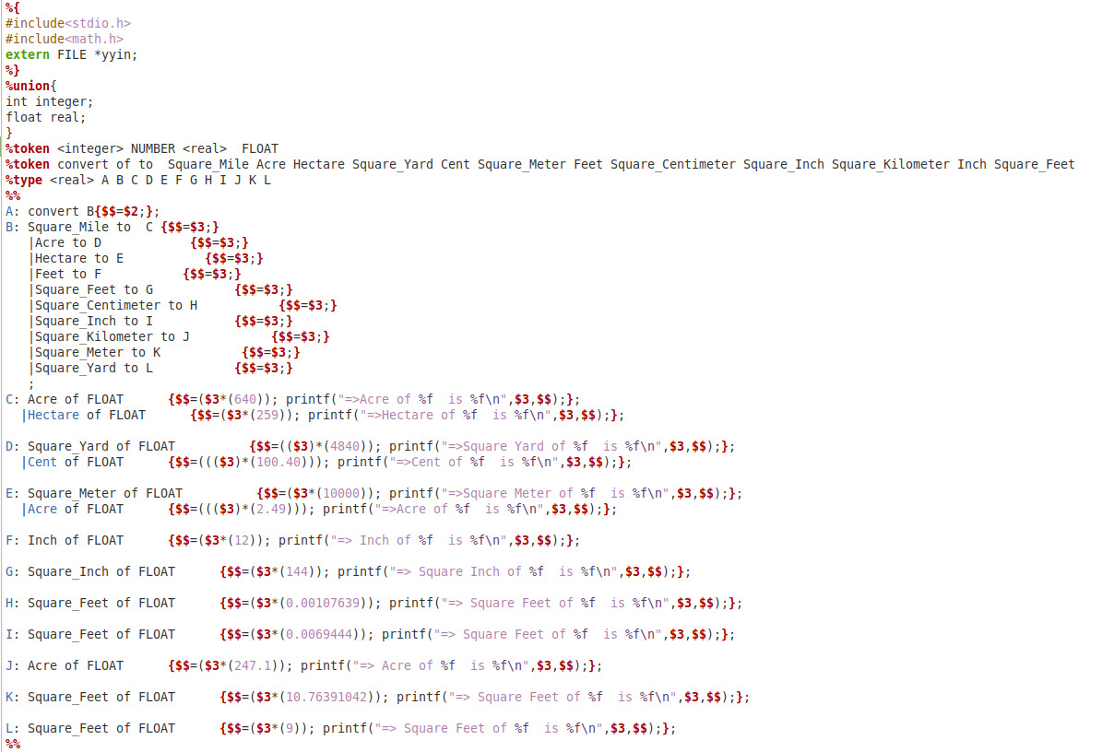
Yacc File:temp1.y

Slide 5
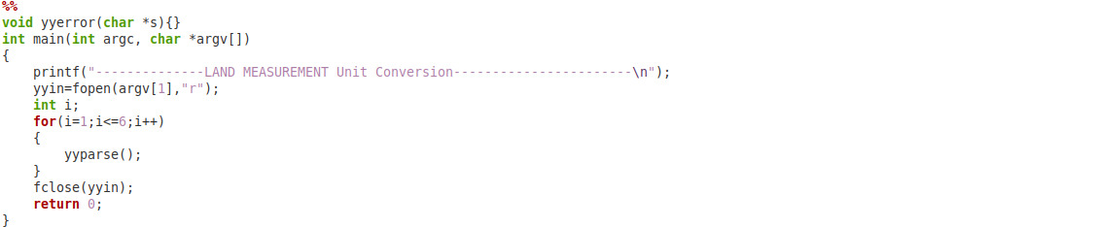

Slide 6
compilation process.
1. flex filename.l
2. It will give lex.yy.c file.
3. bison -dy filename.y
4. It will give y.tab.h and y.tab.c file.
5. gcc lex.yy.c y.tab.c -o name
6. It will give name.exe file.
Now run name.exe file and enter the inputs.

Slide 7
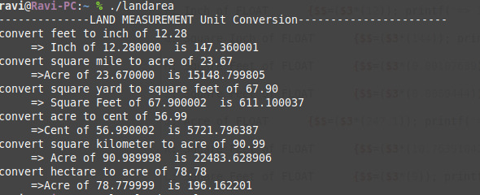
Input output scenarios:

Slide 8
Thank you!!

